Slide 1
Hands-On GenAI: LLMs, RAGs, and Agentic Systems for Beginners
Day 6
Adya Bhat and Tejas Venugopalan

Slide 2
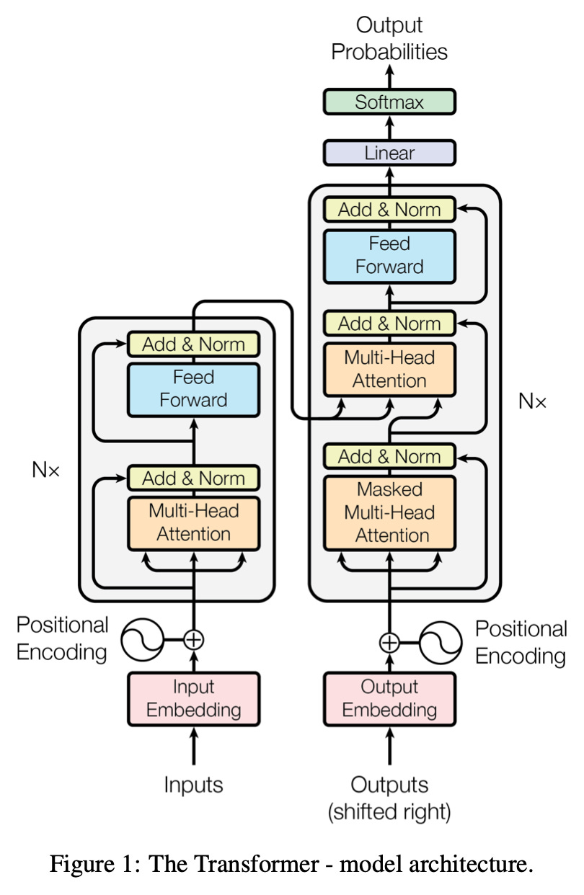
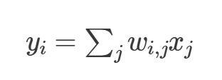
What is Transformer architecture?

Slide 3
What is Transformer architecture?
Components
Encoder — Reads the input sequence and converts it into hidden representations.
Decoder — Generates the output sequence one token at a time, attending to both:
previously generated tokens (decoder self-attention)
encoder outputs (cross-attention).
Shared embeddings — The same embedding layer is used for input and output vocabularies.

Slide 4
What is Transformer architecture?
Tokenization + Text Prefix
T5 uses SentencePiece tokenization (subword units).
Input text:
"summarize: The Indian cricket team won the match by 10 wickets."
→ tokenized into IDs: [13, 245, 56, 999, ...]
Output text:
"India won easily."
→ tokenized into IDs: [500, 23, 789, ...]
T5 uses prefixes (like “summarize:”) to tell the model what task to do.

Slide 5
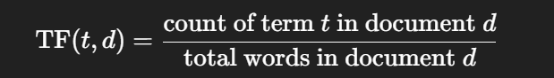
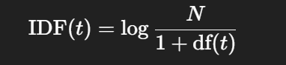

Similarity Search

Slide 6
Example
P1: "Artificial intelligence is the future."
P2: "Machine learning is the future of artificial intelligence."
P3: "The sun is bright today."
["artificial", "intelligence", "is", "the", "future",
"machine", "learning", "of", "sun", "bright", "today"]

Slide 7
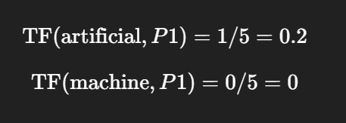
Example
Term | P1 Count | P2 Count | P3 Count
artificial | 1 | 1 | 0
intelligence | 1 | 1 | 0
is | 1 | 1 | 1
the | 1 | 1 | 1
future | 1 | 1 | 0
machine | 0 | 1 | 0
learning | 0 | 1 | 0
of | 0 | 1 | 0
sun | 0 | 0 | 1
bright | 0 | 0 | 1
today | 0 | 0 | 1

Slide 8
Example
Term | df | IDF = log(3 / (1+df))
artificial | 2 | log(3/(1+2)) = log(1) = 0
intelligence | 2 | 0
is | 3 | log(3/4) negative (~ -0.29)
the | 3 | -0.29
future | 2 | 0
machine | 1 | log(3/2) ≈ 0.40
learning | 1 | 0.40
of | 1 | 0.40
sun | 1 | 0.40
bright | 1 | 0.40
today | 1 | 0.40
N = total number of docs = 3
df(t) = number of docs containing term t

Slide 9
Example
Let's write simplified TF-IDF vectors (only for keywords):
P1=[0,0,−0.058,−0.058,0,0,0,0,0,0,0]
P2=[0,0,−0.036,−0.036,0,0.05,0.05,0.05,0,0,0] P3=[0,0,−0.058,−0.058,0,0,0,0,0.08,0.08,0.08]
(Notice: real vectors have all 11 dimensions, but I’ve shown only key weights to keep it readable.)

Slide 10
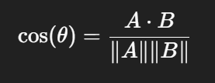
Cosine Similarity
A⋅B sum of pairwise products of components
∥A∥ = Euclidean norm (length of vector)
Let's write simplified TF-IDF vectors (only for keywords):
P1=[0,0,−0.058,−0.058,0,0,0,0,0,0,0]
P2=[0,0,−0.036,−0.036,0,0.05,0.05,0.05,0,0,0] P3=[0,0,−0.058,−0.058,0,0,0,0,0.08,0.08,0.08]
(Notice: real vectors have all 11 dimensions, but I’ve shown only key weights to keep it readable.)

Slide 11
Cosine Similarity
A⋅B sum of pairwise products of components
∥A∥ = Euclidean norm (length of vector)
Let's write simplified TF-IDF vectors (only for keywords):
P1=[0,0,−0.058,−0.058,0,0,0,0,0,0,0]
P2=[0,0,−0.036,−0.036,0,0.05,0.05,0.05,0,0,0] P3=[0,0,−0.058,−0.058,0,0,0,0,0.08,0.08,0.08]
(Notice: real vectors have all 11 dimensions, but I’ve shown only key weights to keep it readable.)
P1⋅P2=(−0.058)(−0.036)+(−0.058)(−0.036)≈0.0042
cos(θP1,P2​)≈0.42

Slide 12
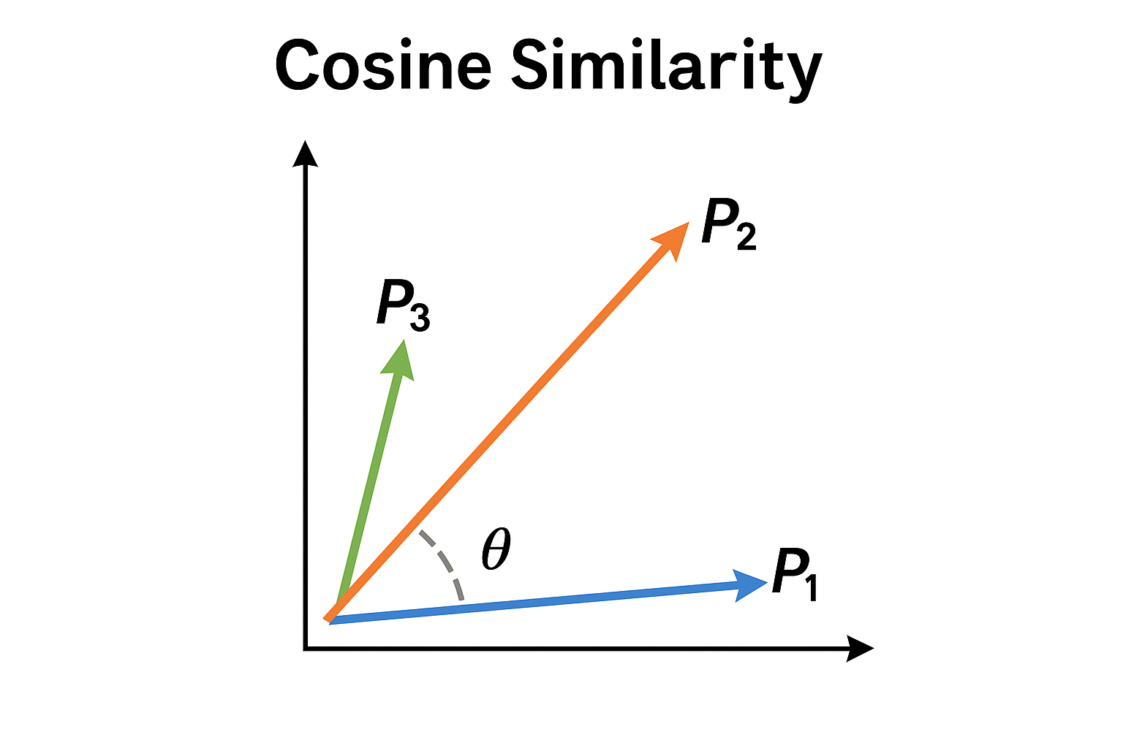
Cosine Similarity
A⋅B sum of pairwise products of components
∥A∥ = Euclidean norm (length of vector)
Let's write simplified TF-IDF vectors (only for keywords):
P1=[0,0,−0.058,−0.058,0,0,0,0,0,0,0]
P2=[0,0,−0.036,−0.036,0,0.05,0.05,0.05,0,0,0] P3=[0,0,−0.058,−0.058,0,0,0,0,0.08,0.08,0.08]
(Notice: real vectors have all 11 dimensions, but I’ve shown only key weights to keep it readable.)
P1⋅P2=(−0.058)(−0.036)+(−0.058)(−0.036)≈0.0042
cos(θP1,P2​)≈0.42

